Slide 1

ESL Red vs Blue Demo
David Thejl-Clayton - @Dcsecuritydk
Dennis Perto - @PertoDK

Slide 2

A little about David...
Lived in Denmark 5 years, with my wife and 2 kids..
Cyber Defence Center Department Manager at JN Data
I love open source security solutions, I run the Security Distractions blog with a friend… https://www.securitydistractions.com/
I am also the chairman of BSides Aarhus, coming summer 2020!

Slide 3
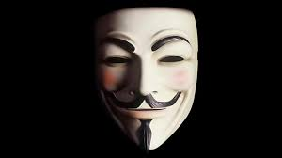
A little about Dennis...
Lived in Denmark 32 years - now with my wife and 3 kids..
Technical Managed Detection & Response lead at Conscia Denmark
I ALSO love open source security solutions. I only blog on Linkedin.
I am the Chapter lead at OWASP Aarhus chapter and also an organizer of BSides Aarhus, coming summer 2020!

Slide 4
Why are we here?

Slide 5
Intro to today
Why do we do what we do?
What is a threat?
Basic incident response process
Intrusion analysis
Mapping into Lockheed Martin Kill Chain
Demo – Featuring “APT Perto”

Slide 6
Why do we do incident response?
The Center for Cyber Security (CFCS) yearly statement:-
Truslen fra cyberspionage er MEGET HØJ.
Truslen fra cyberkriminalitet er MEGET HØJ.
Truslen fra cyberaktivisme er MIDDEL.
https://fe-ddis.dk/cfcs/publikationer/Documents/Cybertruslen-mod-Danmark-2019.pdf

Slide 7
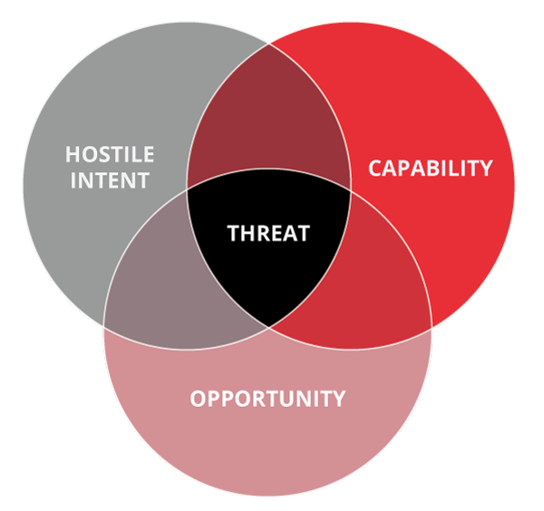
What is a threat?
Intent: Do they have reasons to target you? Competitor?
Capability: Do they have the tooling and skills to carry it through?
Opportunity: Will they get the opening they need?

Slide 8

Opportunity
Opportunity is within the organizations influence:
Public facing vulnerabilities
Technical or design flaws (architecture)
User awareness
NIST IR Preparation stage
The attacker will always get an opportunity…

Slide 9
When opportunity strikes, what next?

Slide 10
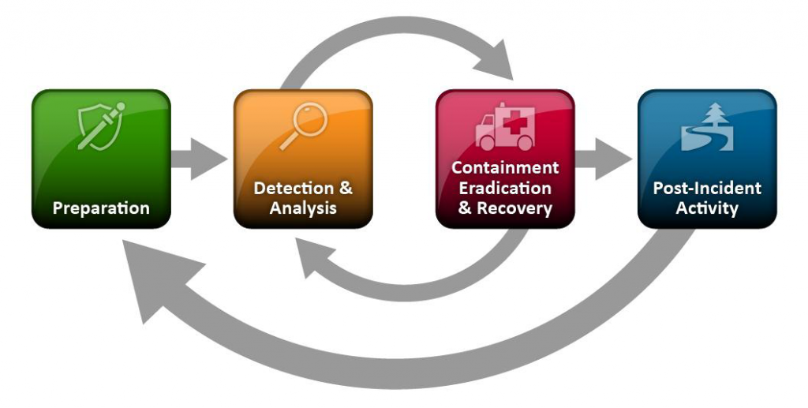
NIST IR model
https://nvlpubs.nist.gov/nistpubs/SpecialPublications/NIST.SP.800-61r2.pdf

Slide 11
How do we operationalize this?

Slide 12
So we know what we need to do, but how to do it?
Stage 1
Alert
Stage 2
Visitation
Stage 3
Analysis
Stage 4
Response
Stage 5
Reporting
Acknowledge
RFI
Response actions
Communication

Slide 13
Intrusion analysis/reporting…

Slide 14
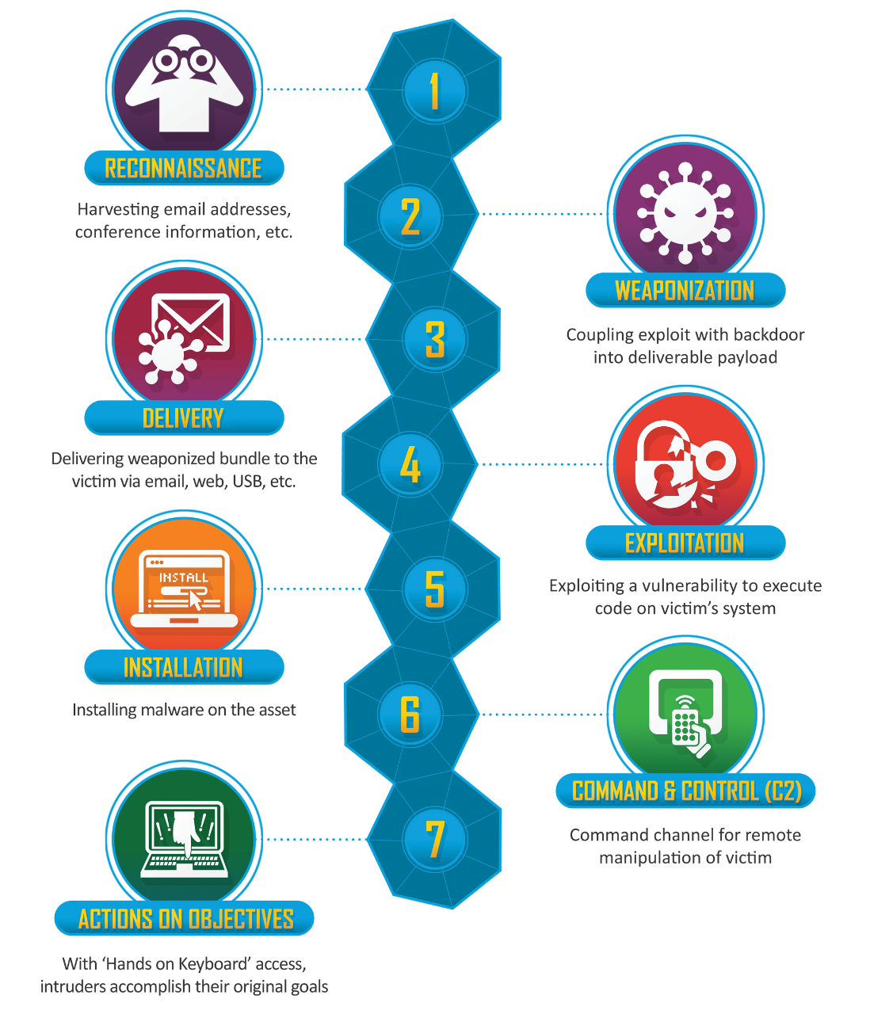
Cyber Kill Chain
Developed by Lockheed Martin
Used to describe the intrusion in steps
Can be combined with diamond model for real intrusion analysis fun!
Can be “chained together”

Slide 15
Plan for the demo
User opens email from a friend – Detect file being downloaded
Reverse shell – Detect c2 domain
Create scheduled task (persistence)
Host recon
Find interesting file – Detect opening of file
Create meterpreter
Deploy shell
Route server network through workstation
Test login works
Move onto Domain Controller with Domain Admin – Detect c2 domain

Slide 16
Kill Chain 1
Recon – Not known
Weaponization – Email
Delivery – Spearphishing attachment
Exploitation – User
Installation – Execution of doc
C2 – Command and control domain
Actions on objectives – Find domain controller

Slide 17
Kill Chain 2
Recon – Host recon
Weaponization – Password file
Delivery – Remote service
Exploitation – Bad administration
Installation – Meterpreter
C2 – Command and control domain
Actions on objectives – Drop ransomware

Slide 18

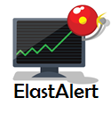


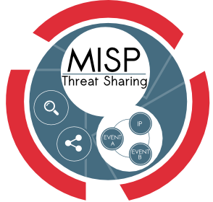






WAN
ELK
TheHive
Util
30.0/24
LAN
20.0/24
DNS
IDS
Proxy
Firewall
Workstation
Windows Domain
SecDis
Domain Controller, File Server
CrownJewels
40.0/24

